Slide 1
PowerShell Scripting for Automation
Nolan Pestano, Intelligent Automation Co-op
Unlocking Potential By Driving Innovation Forward

Slide 2

Agenda
Introduction
Context/Problem
My Solution
More On Batch Scripts
Lessons Learned
Questions

Slide 3




About Nolan
Hi! I’m Nolan Pestano
I am an Intelligent Automation Co-op
University of Missouri Student of Computer Science, go tigers!
Backgrounds include:
Software developing World of Warcraft Hacks
Infrequently paid Standup Comedian based in Kansas City
Cook at Glenn's Café, in Columbia, MO

Slide 4
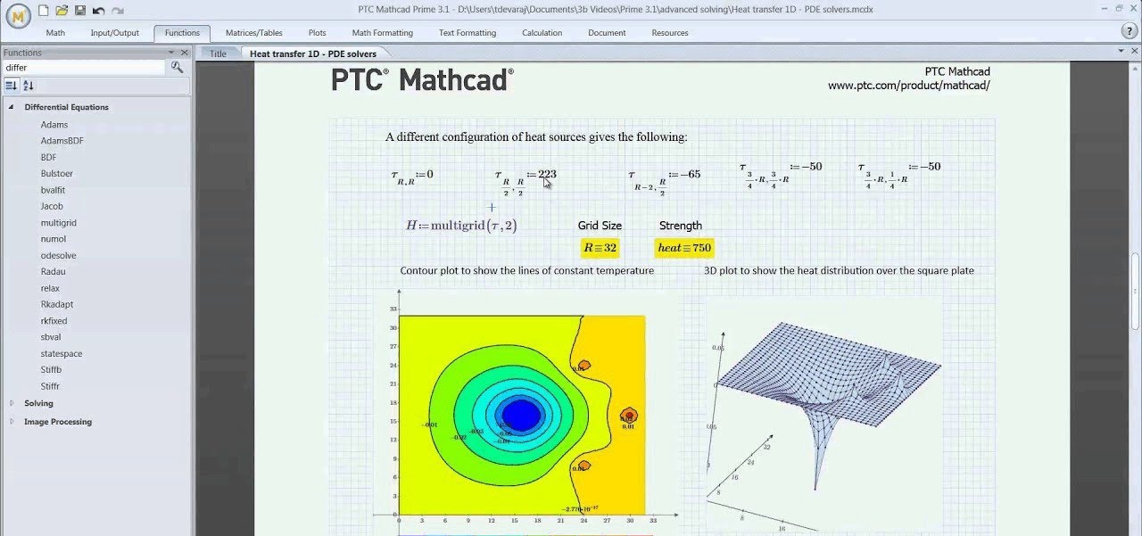
Context
Mathcad is an engineering calculation tool that lets one solve, document, and share math using natural mathematical notation.
This is (generally) used by Mechanical Engineers in Emerson.

Slide 5
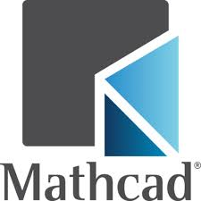
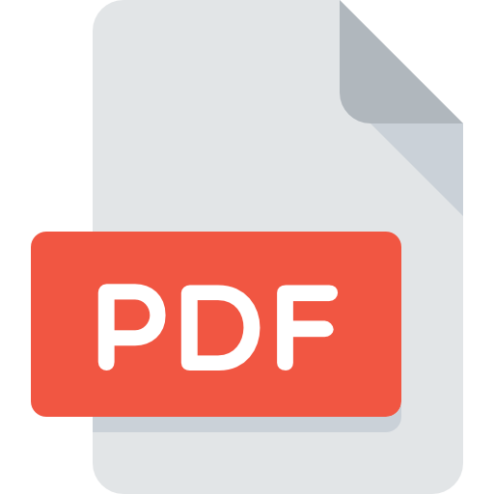
Problem statement
The issue was with all the Mathcad files (.mcdx), there was not an easy way to convert them all to PDFs.
The feature in Mathcad itself for conversion was very messy and not intuitive.

Slide 6
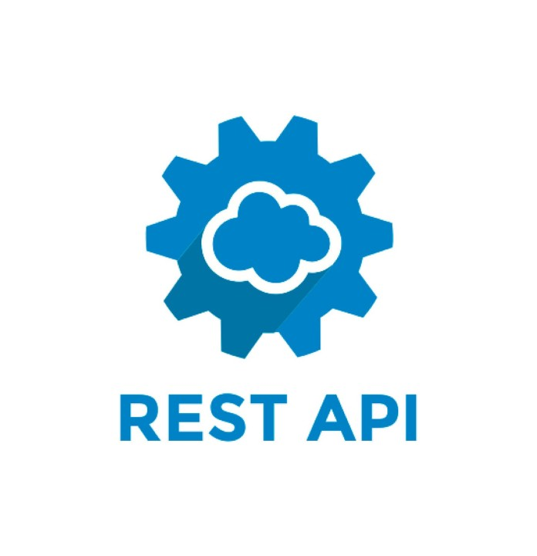
Problem statement
Limited Mathcad automation options
No clean Python or workflow
Documentation assumed manual steps
However,
Familiar feeling from past automation work
Logic was fine, implementation was fragile
Needed something future‑proof

Slide 7
The Key question
What’s the simplest reliable solution?
What already exists on every machine?
What requires the least context to understand later?

Slide 8
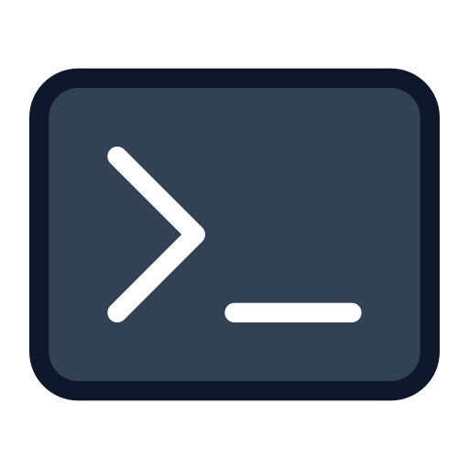
ANSWER: Use Powershell scripting!
Native to Windows
No dependencies
Clear, linear flow

Slide 9
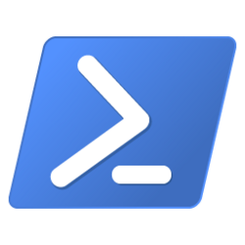
Powershell Crash Course
PowerShell scripting is a windows native language that executes command line interfaces sequentially, the successor to batch files.
If you've ever typed a command in a terminal, then you're already familiar with batch!
PowerShell is great a repeated, medium-logic operations, and file/folder interaction.

Slide 10
Solution Overview
PowerShell‑based automation
Converts all Mathcad files to PDFs
One command, scalable, and portable solution

Slide 11
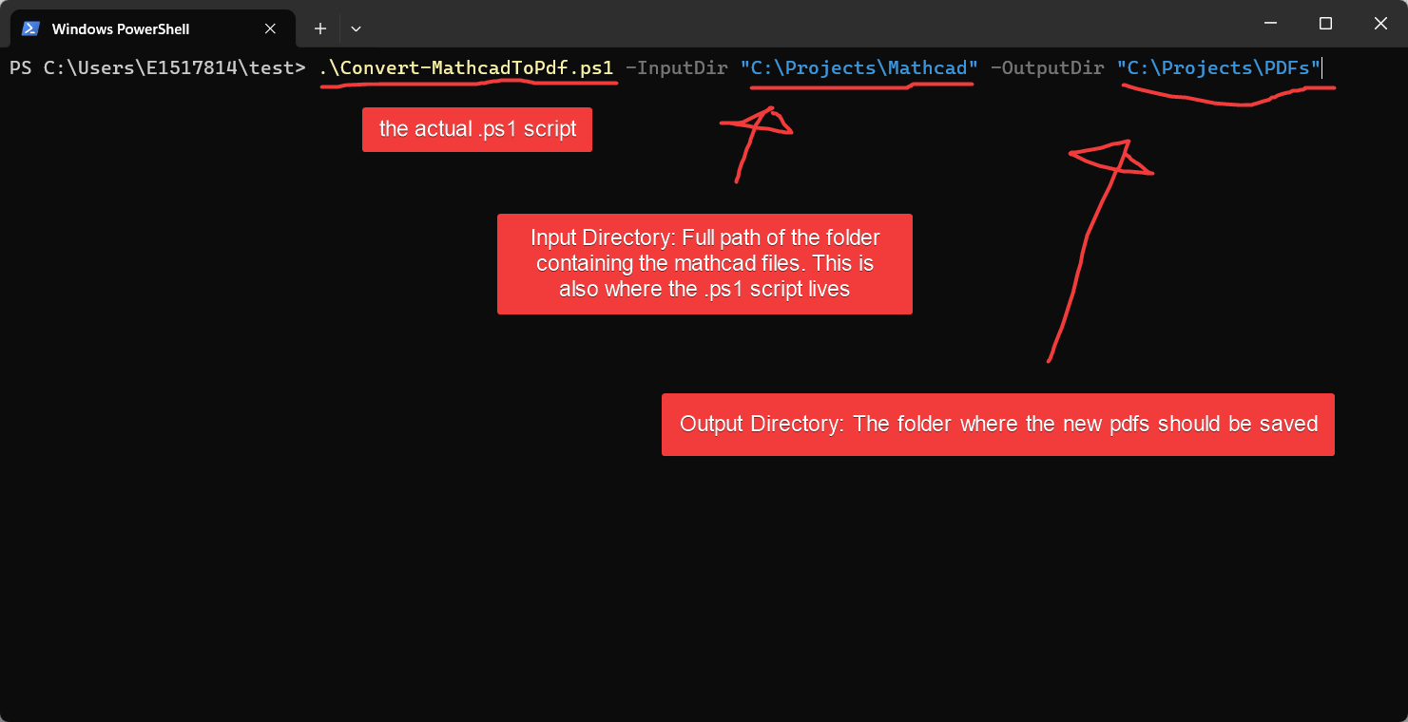
Solution - Inputs & Setup

Slide 12
Solution - Inputs & Setup
Recursively finds all .mcdx files
Loads Mathcad Prime’s automation API

Slide 13
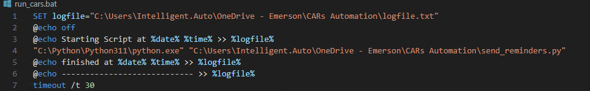
Example run
Every other Wednesday, at 9:00 AM, Windows Task Scheduler runs a Batch File script that executes our Python script and logs its execution.
Further reading, check out Automate the Boring Stuff with Python by Al Sweigart

Slide 14
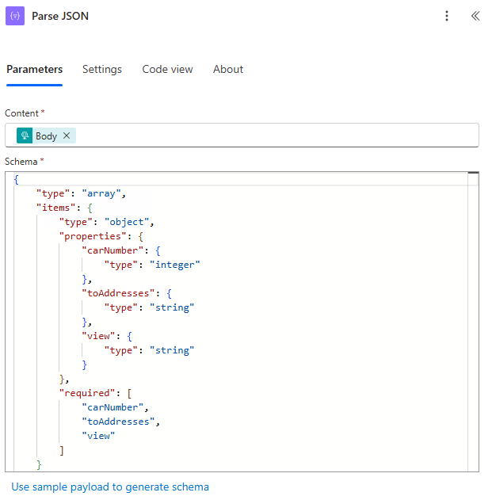
Solution - Inputs & Setup
We can still use Window Task Scheduler still to execute the Python, and then simply just send a POST to Power Automate, instead of an API.
From there, we can let Power Automate send all the emails, after some quick parsing.

Slide 15
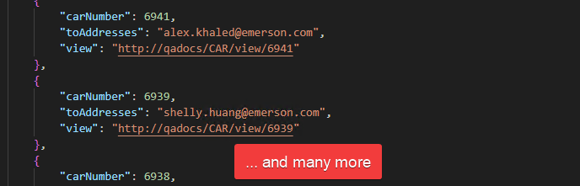
Example Run
Python calls to our database containing the CARS, does some logic to format emails, and eventually formats a JSON body that has needed recipients and relative information.
cars_to_be_sent.json

Slide 16
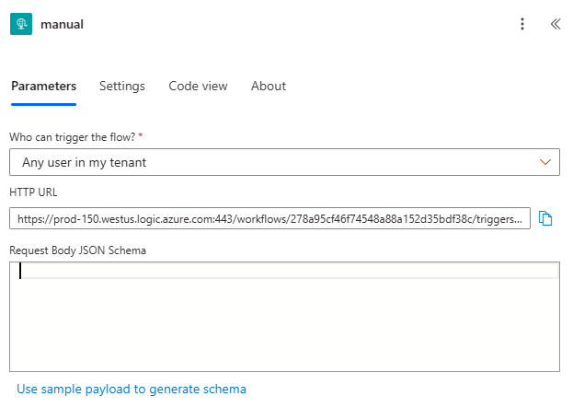
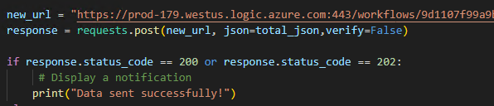
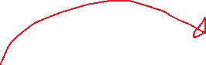
Example Run
The JSON is sent via a HTTP POST method, and Power Automate receives it, which triggers the flow.

Slide 17
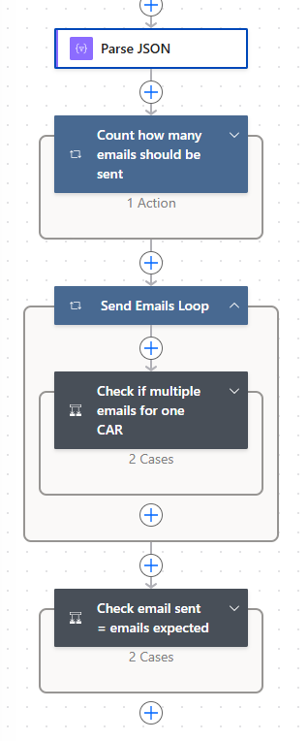
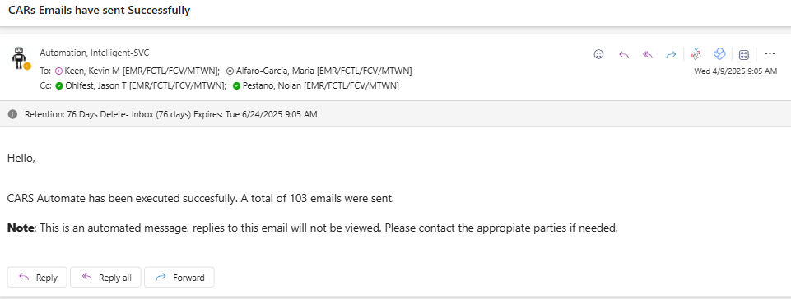
Example Run
Power Automate parses the JSON and sends the emails to the respective partners.
Power Automate also has validation to make sure we send all the emails, sending a status email to stakeholders once it executes fully.

Slide 18
Lessons to learn

Slide 19
Future proof your work!
Eventually your work/code/flows will be “unmaintained”…
Therefore, we as developers should be keen on longevity of our work.
Future proofing is not just adding stuff, but more so creating robust, easy to read code, such that maintenance is easy.
When developing, think about how a future developer with zero context would debug.

Slide 20
Things will break eventually, leave a good trace of what went wrong
Logs, stack traces, error handling-- make errors clear as to what went wrong.
Document and comment your works!
Power Automate has the note feature
“Everyone knows that debugging is twice as hard as writing a program in the first place. So if you're as clever as you can be when you write it, how will you ever debug it?”
Dennis Ritchie, “C Programming Language”

Slide 21
Questions?

